Slide 1
ITP171 IT FUNDAMENTALS and PROJECT
Cloud Computing

Slide 2
How Cloud Computing works?
MUST WATCH this!!
What is Cloud Computing?
https://youtu.be/Mzl4Wud_Bp0
What is the Pros and Cons?
What is the considerations?
Examples of Cloud Computing applications.
https://youtu.be/DGDtujmOBKc

Slide 3
Evolution of Cloud Computing
To understand what cloud computing is and is not, it is important to understand how this model of computing has evolved
Cloud computing is not something revolutionary, but an evolution
As a service delivery model using Internet, we can see how it has evolved from earlier basic Internet Service Provider model

Slide 4
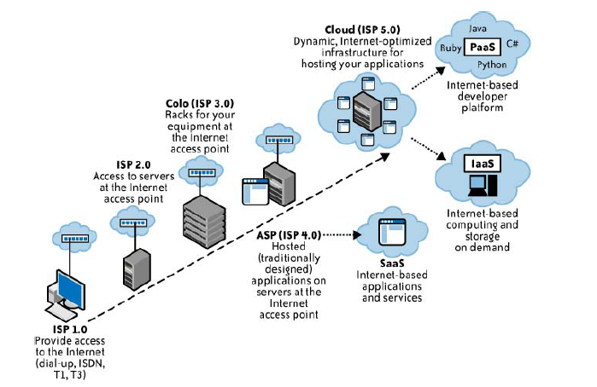
ISP Models Evolution

Slide 5
What is Cloud Computing?
Buzzword? Hype?
The term “Cloud computing” is often used in discordant context, referring to very different and distinct things
Gmail? Amazon EC3?
Cloud computing is the evolution of a variety of technologies that have come together to alter an organization’s approach to build IT infrastructure

Slide 6
What is Cloud Computing?
Like Web decade ago, there is nothing fundamentally new in any of the technologies that make up cloud computing
It is how these things are put together and make them accessible to the masses
Cloud can be both hardware and software
Why we call it “cloud”?
  Internet is usually represented by a cloud symbol
  We don’t really care where the particular server is or where out software is running. It is somewhere out there in the “cloud”

Slide 7
A Definition
National Institute of Standards and Technology (NIST)
  Cloud computing is a model for enabling convenient, on-demand network access to a shared pool of configurable computing resources (e.g., networks, servers, storage, applications, and services) that can be rapidly provisioned and released with minimal management effort or service provider interaction. This cloud model promotes availability and is composed of five essential characteristics, three service models, and four deployment models.

Slide 8
Defining Characteristics
Broad network access
  Capabilities are available over the network and accessed through standard mechanisms that promote use by heterogeneous thin or thick client platforms (e.g., mobile phones, laptops, and PDAs).
Resource Pooling
  resources are shared (i.e., multiple users use the same resource) at the network level, host level, and application level.
Rapid Elasticity
  Rapidly increase and decrease their computing resources as needed, as well as release resources for other uses when they are no longer required.

Slide 9
Defining Characteristics
Measured Service
  Resource usage can be monitored, controlled, and reported providing transparency for both the provider and consumer of the utilized service. Service is metered and billed if needed.
On-demand self-service
  A consumer can unilaterally provision computing capabilities (e.g server time, network storage) as needed automatically without requiring human interaction with each service’s provider
(James Governer 15-ways-to-tell-its-not-cloud-computing

Slide 10
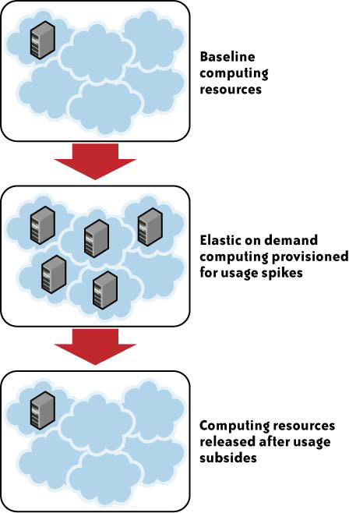
Elasticity

Slide 11
Cloud Computing Service Models
Concept of services
  Reusable , fine-grained components offered
Different services delivered from the cloud
  Software as a service (SaaS)
  Platform as a service (PaaS)
  Infrastructure as a service (IaaS)
  Everything as a Service (EAAS, XaaS, *aaS)
    Communication as a Service
    Monitoring as a Service
    Security as a Service
  https://youtu.be/whkyRvugqlM

Slide 12
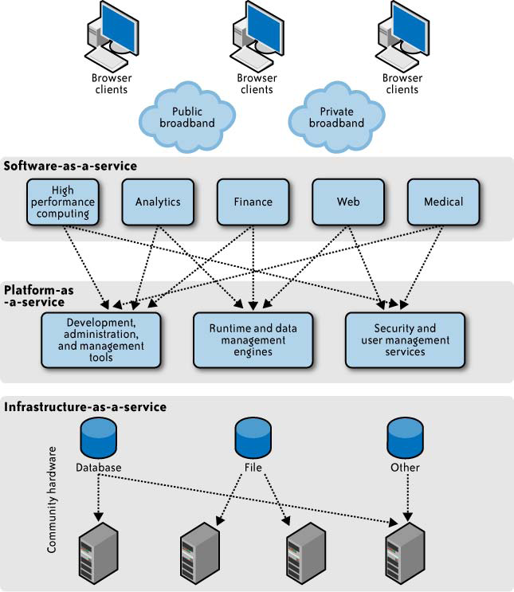
Service Models

Slide 13
SaaS – Software as a service
SaaS is the model in which an application is hosted as service to customers who access it through Internet
Software is licensed on a subscription basis
Types of Software Applications
  CRM
  Accounting
  Web content management

Slide 14
PaaS- Platform as a Service
Provides resources required to build applications and services
Includes application design, development, testing, deployment and hosting
Other services include:
  Team collaboration
  Web service integration
  Database integration
  Security

Slide 15
IaaS-Infra-Structure as a service
Delivery of computer infrastructure as a service.
Infrastructure includes:
  Computer hardware
  Computer network
  Server (OS)
  Storage

Slide 16
The Big Players in Cloud Computing
Adobe CC
  Target segment: SaaS (provide online services)
Amazon
  Target segment: IaaS (through its Amazon Web Services such as EC2 (Compute power), S3 (Storage) and VPC (Virtual Private Network)
Google
  Target segment: PaaS (through its Google App Engine), and SaaS (through its Google Docs, Gmail, etc)
Microsoft
  Target segment: PaaS (through its Windows Azure) and SaaS (through its Microsoft Office Live Small Business)
SalesForce.com
  Target segment: PaaS (through its AppExchange) and SaaS (through its Salesforce CRM)

Slide 17
Three Ways of Cloud Compute
https://youtu.be/SgujaIzkwrE
It explains the SaaS, PaaS and IaaS.
Must Watch this.

Slide 18
Deployment models
There are many considerations for cloud computing architects to make when moving from a standard enterprise application deployment model to a cloud-based model.
We can choose to deploy to private cloud, community cloud, public cloud, or hybrid cloud

Slide 19
Private Cloud
Built for the exclusive use of one client, providing the utmost control over data, security, and quality of service
The company owns the infrastructure
May be deployed in an enterprise datacenter, or at a colocation facility.
Built and managed by a company’s own IT organization or by a cloud provider.

Slide 20
Public Cloud
Run by third parties, and applications from different customers are likely to be mixed together on the cloud’s servers, storage systems, and networks
Hosted away from customer premises
Can be much larger than a company’s private cloud, offering the ability to scale up and down on demand
  Shift infrastructure risks from enterprise to cloud provider
Virtual Private Datacenter
  Portions of a public cloud can be carved out for the exclusive use of a single client
  Gives customers greater visibility into its infrastructure

Slide 21
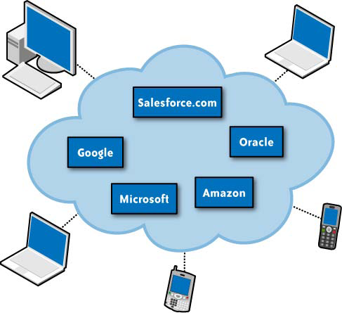
Public Cloud

Slide 22
Hybrid Cloud
Combine both public and private cloud models
Augment a private cloud with the resources of a public cloud
  can be used to maintain service levels in the face of rapid workload fluctuations
  Use of storage clouds to support Web 2.0 applications.
  Used to handle planned workload spikes.
  Sometimes called “surge computing,” a public cloud can be used to perform periodic tasks that can be deployed easily on a public cloud.

Slide 23
Hybrid Cloud
Complexity in determining how to distribute applications across both a public and private cloud.
  Relationship between data and processing resources.
  If the data is small, or the application is stateless, a hybrid cloud can be much more successful than if large amounts of data must be transferred into a public cloud for a small amount of processing

Slide 24
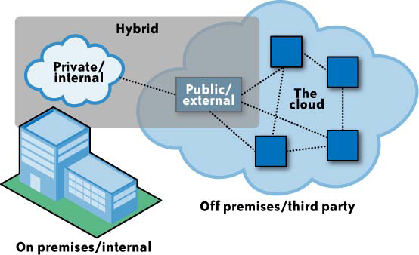
Hybrid Cloud

Slide 25
Why Cloud Computing?
Ease the software maintenance
  No CD to install on all computers
  No need to worry about software upgrade
Convenient for telecommuters
  Simply log in and use the applications anywhere, and anytime
No equipment outlay required
  No need to pay for servers not required
  Guard against obsolete hardware
  No need to worry about capacity planning
    Add and remove capacity anytime

Slide 26
Why Cloud Computing?
Redundancy and disaster planning
  Let the cloud provider take care of ensuring redundancy for your storage and applications
  Let the cloud provider take care of disaster planning
    Off-site backup, alternative locations, etc.

Slide 27
Why NOT?
Network outage or problems with ISP
  Cut off access to applications or servers
Sensitive information
  Security concern
Application integration issues
  Difficult to integrate your applications if they are geographically dispersed

Slide 28
Conclusions
Question
  What happens when there are too many clouds?

